Slide 1
CHAPTER 7
SORTING
All the programs in this file are selected from
Ellis Horowitz, Sartaj Sahni, and Susan Anderson-Freed
“Fundamentals of Data Structures in C”,
Computer Science Press, 1992.
CHAPTER 7

Slide 2
Sequential Search
Example
44, 55, 12, 42, 94, 18, 06, 67
CHAPTER 7

Slide 3
* (P.320)
# define MAX-SIZE 1000/* maximum size of list plus one */ typedef struct { int key;
/* other fields */
} element; element list[MAX_SIZE];
CHAPTER 7

Slide 4
*Program 7.1:Sequential search (p.321) int seqsearch( int list[ ], int searchnum, int n )
{
/*search an array, list, that has n numbers. Return i, if list[i]=searchnum. Return -1, if searchnum is not in the list */ int i; list[n]=searchnum; sentinel for (i=0; list[i] != searchnum; i++)
; return (( i<n) ? i : -1);
}
CHAPTER 7

Slide 5
*Program 7.2: Binary search (p.322) int binsearch(element list[ ], int searchnum, int n)
{
/* search list [0], ..., list[n-1]*/ int left = 0, right = n-1, middle; while (left <= right) { middle = (left+ right)/2; switch (COMPARE(list[middle].key, searchnum)) { case -1: left = middle +1; break; case 0: return middle; case 1:right = middle - 1;
}
} return -1;
}
O(log₂n)
CHAPTER 7

Slide 6
Sorting Problem
Definition
  given (R₀, R₁, …, R_{n-1}), where R_{i} = key + data find a permutation σ, such that K_{σ(i-1)} ≤ K_{σ(i)}, 0<i<n-1
sorted
  K_{σ(i-1)} ≤ K_{σ(i)}, 0<i<n-1
CHAPTER 7

Slide 7
Quick Sort (C.A.R. Hoare)
Quick sort is developed by C. A. R. Hoare. The quick sort scheme has the best average behavior among the sorting methods.
In Quick sort the pivot key K_{i} is placed at the correct spot with respect to the whole list. K_{j} ≤ K_{s(i)} for j < s(i) and K_{j} ≥ s(i) for j > s(i).
Therefore, the sublist to the left of S(i) and to the right of s(i) can be sorted independently.

Slide 8
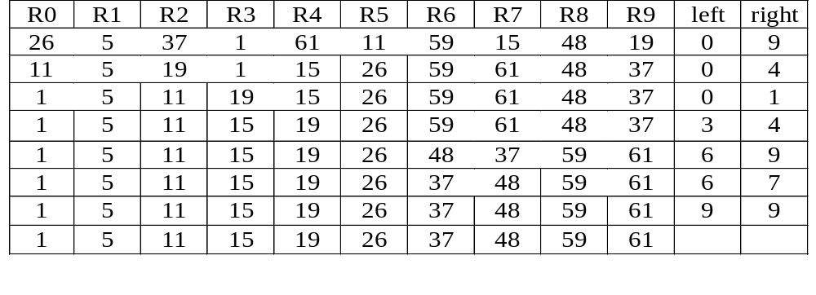
Example for Quick Sort
{
}
{
}
{
}
{
}
{
}
{
}
{
}
{
}
{
}
{
}
CHAPTER 7

Slide 9
Quick Sort
void quicksort(element list[], int left, int right)
{
int pivot, i, j;
element temp;
if (left < right) {
i = left; j = right+1;
pivot = list[left].key;
do {
do i++; while (list[i].key < pivot);
do j--; while (list[j].key > pivot);
if (i < j) SWAP(list[i], list[j], temp);
} while (i < j);
SWAP(list[left], list[j], temp);
quicksort(list, left, j-1);
quicksort(list, j+1, right);
}
}
CHAPTER 7

Slide 10
Analysis for Quick Sort
  The worst case O(n²)
Assume that each time a record is positioned, the list is divided into the rough same size of two parts. Positioning within the list with n element needs O(n)
  Assume T(n) is the time taken to sort a list of size n:
T(n)<=cn+2T(n/2) for some c
<=cn+2(cn/2+2T(n/4))
...
<=cnlog n+nT(1)
=O(nlog n)
CHAPTER 7

Slide 11
Analysis of Quick Sort
Quick sort needs stack space to implement the recursion.
If the lists split evenly, the maximum recursion depth would be log n and the stack space is of O(log n).
The worst case is when the lists split into a left sublist of size n – 1 and a right sublist of size 0 at each level of recursion. In this case, the recursion depth is n, the stack space of O(n).
The worst case stack space can be reduced by a factor of 4 by realizing that right sublists of size less than 2 need not be stacked. Asymptotic reduction in stack space can be achieved by sorting smaller sublists first. In this case the additional stack space is at most O(log n).

Slide 12
Time and Space for Quick Sort
Space complexity:
  Average case and best case: O(log n)
  Worst case: O(n)
Time complexity:
  Average case and best case: O(n log n)
  Worst case: O(n )
2
CHAPTER 7

Slide 13
Merge Sort
Given two sorted lists
(A, m)
(B, n)
generate a single sorted list
(C, m+n)
CHAPTER 7

Slide 14
Merge Sort
The process of merging of two sorted lists into a single sorted list is called simple merge.
CHAPTER 7

Slide 15
Example
10 | 20 | 40 | 50 | 15 | 25 | 30 | 10
10 | 20 | 40 | 50 | 15 | 25 | 30 | 10 | 15
10 | 20 | 40 | 50 | 15 | 25 | 30 | 10 | 15 | 20
10 | 20 | 40 | 50 | 15 | 25 | 30 | 10 | 15 | 20 | 25
10 | 20 | 40 | 50 | 15 | 25 | 30 | 10 | 15 | 20 | 25 | 30
10 | 20 | 40 | 50 | 15 | 25 | 30 | 10 | 15 | 20 | 25 | 30 | 40 | 50
10 | 20 | 40 | 50 | 15 | 25 | 30
CHAPTER 7

Slide 16
Merge Sort
void simplemerge(int A[], int B[], int m, int n)
{
int i,j,k;
i=j=k=0;
while (i<m && j<n) {
if (A[i]<B[j])
C[k++]= A[i++];
else
C[k++]= B[j++];
}
while (i<m) C[k++]= A[i++];
while(j<n) C[k++] = B[j++];
}
CHAPTER 7

Slide 17
Recursive Merge Sort
lower
upper
void MergeSort(element list[], int low, int high)
{
int middle;
if (low < high) {
mid = (low+high)/2;
MergeSort(list,low,mid);
MergeSort(list,mid+1,high),
SimpleMerge(list, low, mid, high);
}
}
Point to the start of sorted chain
lower
middle
upper
CHAPTER 7

Slide 18
Nature Merge Sort
26 5 77 1 61 11 59 15 48 19
5 26 77
1 11 59 61
15 19 48
1 5 11 26 59 61 77
15 19 48
1 5 11 15 19 26 48 59 61 77
CHAPTER 7

Slide 19
*Figure 7.11: Array interpreted as a binary tree (p.349)
Heap Sort
1 2 3 4 5 6 7 8 9 10
26 5 77 1 61 11 59 15 48 19
input file
[1]
26
[2]
5
[3]
77
[4]
1
[5]
61
[6]
11
[7]
59
[8]
15
[9]
48
[10]
19
CHAPTER 7

Slide 20
*Figure 7.12: Max heap following first for loop of heapsort(p.350)
initial heap
[1]
77
[2]
61
[3]
59
exchange
[4]
48
[5]
19
[6]
11
[7]
26
[8]
15
[9]
1
[10]
5
CHAPTER 7

Slide 21
Figure 7.13: Heap sort example(p.351)
[1]
61
[2]
48
[3]
59
15
19
11
[7]
26
[4]
[5]
[6]
[8]
5
[9]
1
[10]
77
(a)
[1]
59
[2]
48
[3]
26
15
19
11
[7]
1
[4]
[5]
[6]
[8]
5
[9]
61
[10]
77
(b)
CHAPTER 7

Slide 22
Figure 7.13(continued): Heap sort example(p.351)
[1]
48
[2]
19
[3]
26
15
5
11
[7]
1
[4]
[5]
[6]
59
59
61
[8]
[9]
61
[10]
77
(c)
[1]
26
[2]
19
[3]
11
48
15
5
1
[7]
48
[4]
[5]
[6]
59
[8]
59
[9]
61
[10]
77
(d)
CHAPTER 7

Slide 23
Heap Sort
void adjust(element list[], int root, int n)
{
int child, rootkey; element temp;
temp=list[root]; rootkey=list[root].key;
child=2*root;
while (child <= n) {
if ((child < n) &&
(list[child].key < list[child+1].key))
child++;
if (rootkey > list[child].key) break;
else {
list[child/2] = list[child];
child *= 2;
}
}
list[child/2] = temp;
}
i
2i
2i+1
CHAPTER 7

Slide 24
Heap Sort
void heapsort(element list[], int n)
{
int i, j;
element temp;
for (i=n/2; i>0; i--) adjust(list, i, n);
for (i=n-1; i>0; i--) {
SWAP(list[1], list[i+1], temp);
adjust(list, 1, i);
}
}
ascending order (max heap)
bottom-up
n-1 cylces
top-down
CHAPTER 7

Slide 25
Radix Sort
Sort by keys
K⁰, K¹, …, K^{r-1}
Most significant key
Least significant key
R₀, R₁, …, R_{n-1} are said to be sorted w.r.t. K₀, K₁, …, K_{r-1} iff
0≤i<n-1
Most significant digit first: sort on K⁰, then K¹, ...
Least significant digit first: sort on K^{r-1}, then K^{r-2}, ...
CHAPTER 7

Slide 26
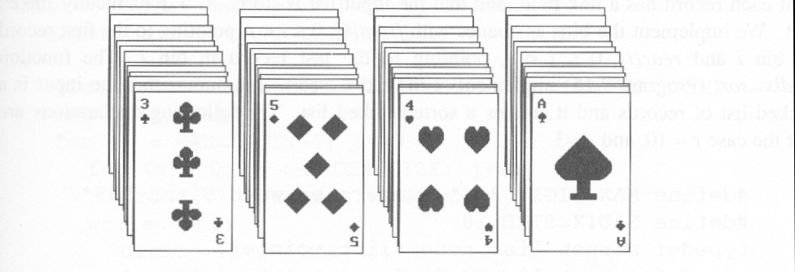
Figure 7.14: Arrangement of cards after first pass of an MSD sort(p.353)
Suits: ♣ < ♦ < ♥ < ♠
Face values: 2 < 3 < 4 < … < J < Q < K < A
(1) MSD sort first, e.g., bin sort, four bins ♣ ♦ ♥ ♠
LSD sort second, e.g., insertion sort
(2) LSD sort first, e.g., bin sort, 13 bins
2, 3, 4, …, 10, J, Q, K, A
MSD sort, e.g., bin sort four bins ♣ ♦ ♥ ♠
CHAPTER 7

Slide 27
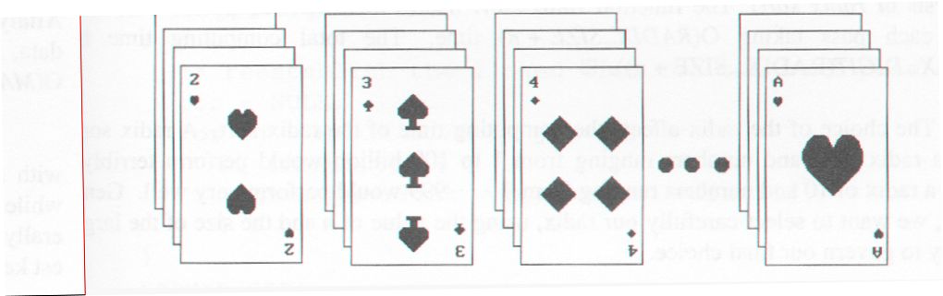
Figure 7.15: Arrangement of cards after first pass of LSD sort (p.353)
CHAPTER 7

Slide 28
Radix Sort
0 ≤ K ≤ 999
(K⁰, K¹, K²)
MSD
LSD
0-9
0-9
0-9
radix 10 sort
radix 2 sort
CHAPTER 7

Slide 29
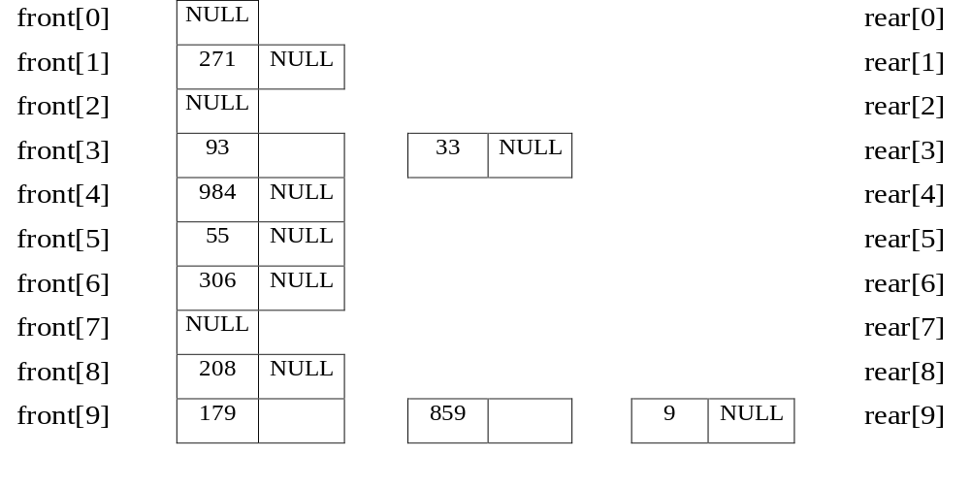
Example for LSD Radix Sort
d (digit) = 3, r (radix) = 10 ascending order
179, 208, 306, 93, 859, 984, 55, 9, 271, 33
Sort by digit
concatenate
271, 93, 33, 984, 55, 306, 208, 179, 859, 9 After the first pass
CHAPTER 7

Slide 30
front[0]
306
208
9
null
rear[0]
front[1]
null
rear[1]
front[2]
null
rear[2]
front[3]
33
null
rear[3]
front[4]
null
rear[4]
front[5]
55
859
null
rear[5]
front[6]
null
rear[6]
front[7]
271
179
null
rear[7]
front[8]
984
null
rear[8]
front[9]
93
null
CHAPTER 7
306, 208, 9, 33, 55, 859, 271, 179, 984, 93 (second pass)
rear[9]

Slide 31
front[0]
9
33
55
93
null
rear[0]
front[1]
179
null
rear[1]
front[2]
208
271
null
rear[2]
front[3]
306
null
rear[3]
front[4]
null
rear[4]
front[5]
null
rear[5]
front[6]
null
rear[6]
front[7]
null
rear[7]
front[8]
859
null
rear[8]
front[9]
984
null
CHAPTER 7
9, 33, 55, 93, 179, 208, 271, 306, 859, 984 (third pass)
rear[9]

Slide 32
Data Structures for LSD Radix Sort
An LSD radix r sort,
R0, R1, ..., Rn-1 have the keys that are d-tuples
(x0, x1, ..., xd-1)
#define MAX_DIGIT 3
#define RADIX_SIZE 10
typedef struct list_node *list_pointer;
typedef struct list_node {
int key[MAX_DIGIT];
list_pointer link;
}
CHAPTER 7

Slide 33
LSD Radix Sort
list_pointer radix_sort(list_pointer ptr)
{
list_pointer front[RADIX_SIZE],
rear[RADIX_SIZE];
int i, j, digit;
for (i=MAX_DIGIT-1; i>=0; i--) {
for (j=0; j<RADIX_SIZE; j++)
front[j]=read[j]=NULL;
while (ptr) {
digit=ptr->key[I];
if (!front[digit]) front[digit]=ptr;
else rear[digit]->link=ptr;
Initialize bins to be
empty queue.
Put records into queues.
CHAPTER 7

Slide 34
rear[digit]=ptr;
ptr=ptr->link;
}
/* reestablish the linked list for the next pass */
ptr= NULL;
for (j=RADIX_SIZE-1; j>=0; j++)
if (front[j]) {
rear[j]->link=ptr;
ptr=front[j];
}
}
return ptr;
}
O(n)
Get next record.
O(d(n+r))
O(r)
CHAPTER 7

